Slide 1
Electricity Consumption and Renewable Energy Generation
in Colorado
Gold-Diggers
Yaquan Yang, Weixiao Li, Haocheng Zhu

Slide 2
Introduction
It has been observed that electricity consumption in Colorado has been increasing in recent years.Growing energy demand has led to a focus on renewable energy.
This project uses a variety of machine learning models and time series models in an attempt to study the impact of consumer behavior on energy consumption and renewable energy conservation.
The results show an upward trend in the production and consumption of renewable energy sources, while the consumption of non-renewable energy sources shows a downward trend.
The results of this analysis will provide insight into the potential impact of consumer behavior on energy consumption and renewable energy conservation.

Slide 3
Data source
Electricity_Revenue_by_Utility_in_Colorado.csv:https://data.colorado.gov/Business/Electricity-Revenue-by-Utility-in-Colorado/gdh8-8pg4
Electricity_Revenue_in_Colorado.csv:https://data.colorado.gov/Business/Electricity-Revenue-in-Colorado/q6sk-tjm9
prod_btu_re_te:https://www.eia.gov/state/seds/seds-data-complete.php?sid=US#StatisticsIndicators
Prod_dataset:https://www.eia.gov/state/seds/seds-data-complete.php?sid=AL#CompleteDataFile
use_all_btu:https://www.eia.gov/state/seds/seds-data-complete.php?sid=AL#Consumption

Slide 4
Electricity Consumption
Electricity Market Size & Trends
The electricity market in Colorado has grown year by year since 1990, and the monthly electricity consumption has gradually increased.
Especially in recent years, with the increase in population and economic development, the size of the electricity market has shown a rapid growth trend.
At the same time, the level of electricity prices has also changed with the size of the market, with prices fluctuating, but generally showing an upward trend.

Slide 5
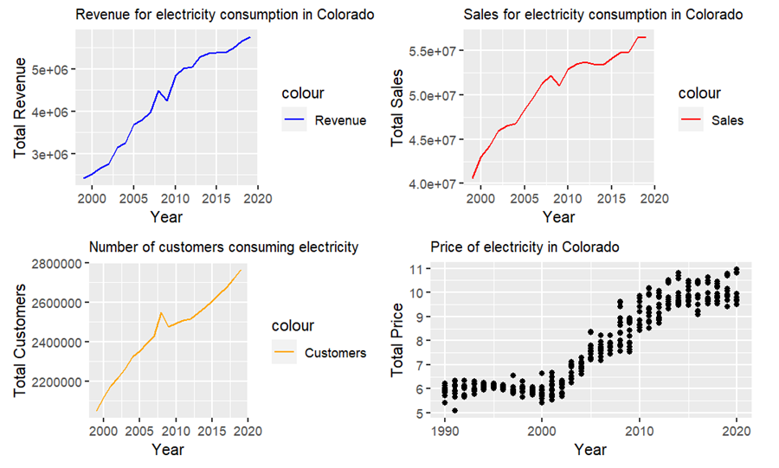
Electricity Consumption
Rising demand may be driving renewable energy generation.

Slide 6
Electricity Consumption
Different machine learning algorithms to regress and predict the total electricity sales in Colorado to determine how electricity demand has changed over the last three decades.
Multiple linear regression
Decision Tree
Random Forest
Support vector machine

Slide 7
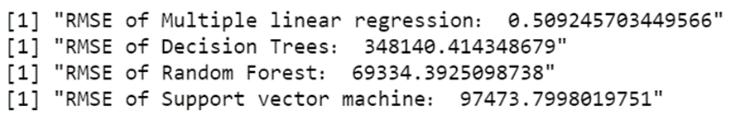
Model Check
Electricity Consumption
From the root mean square error (RMSE) of these four models, we can see that the multiple linear regression model performs best in predicting electricity sales, which may be related to the linear relationship between the response variable and the predictor variable.

Slide 8
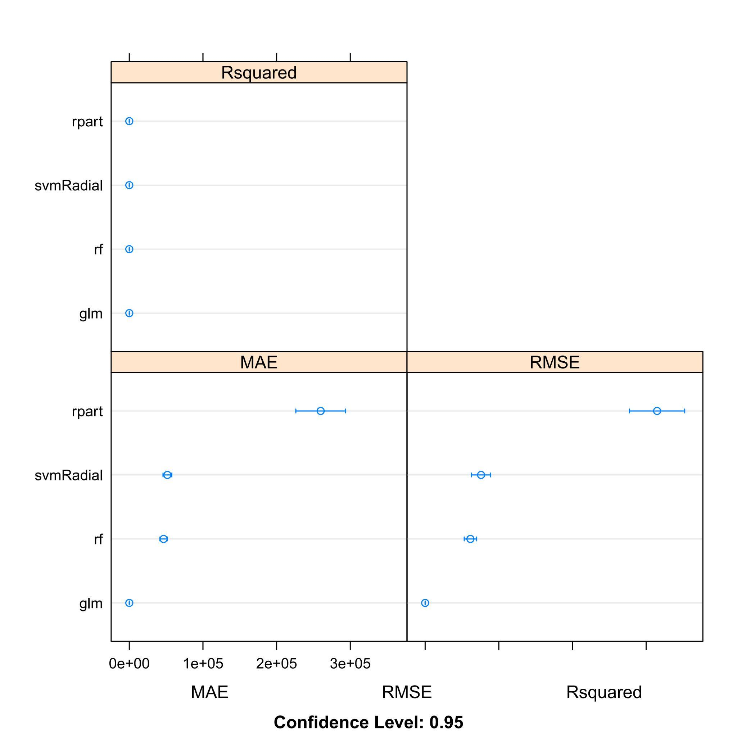
Ensemble
Electricity Consumption
Now we train multiple models simultaneously, cross-validate them and calculate evaluation metrics that help us choose the best model.
From the Mean Absolute Error(MAE) and root mean square error (RMSE) shows that the best performing model is multiple linear regression

Slide 9
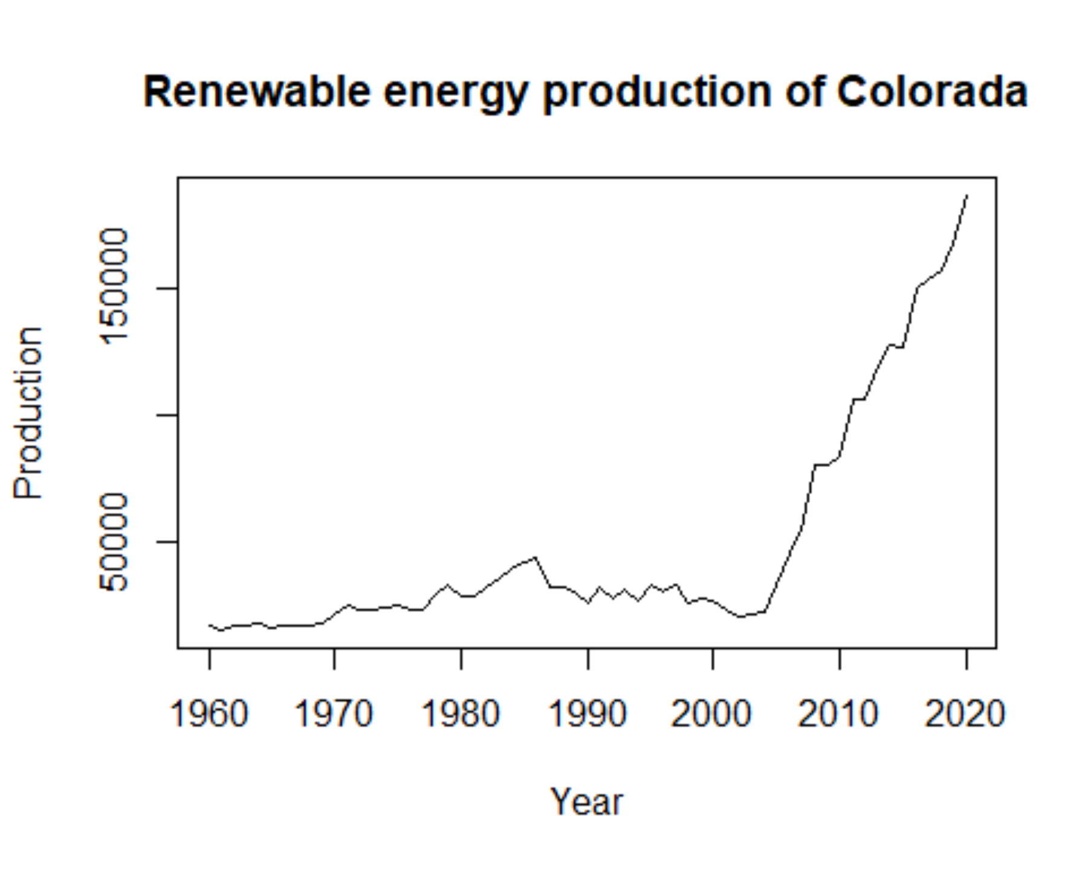
Renewable Energy Analysis
There is generally an apparent upward trend, so it seems not stationary.
In order to do the following analysis and forecast works. we need to do transformations.

Slide 10
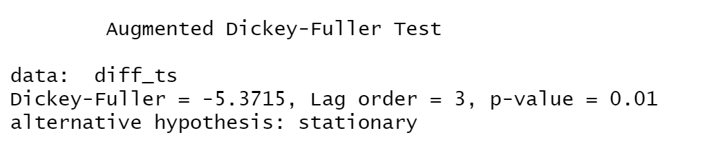
Renewable Energy Analysis
To eliminate the trend, we performed two differentials on the data.
Take Dicky-Fuller (DF) Test, the results show that the p- value < 0.05, rejecting the original hypothesis and the data is stationary.

Slide 11
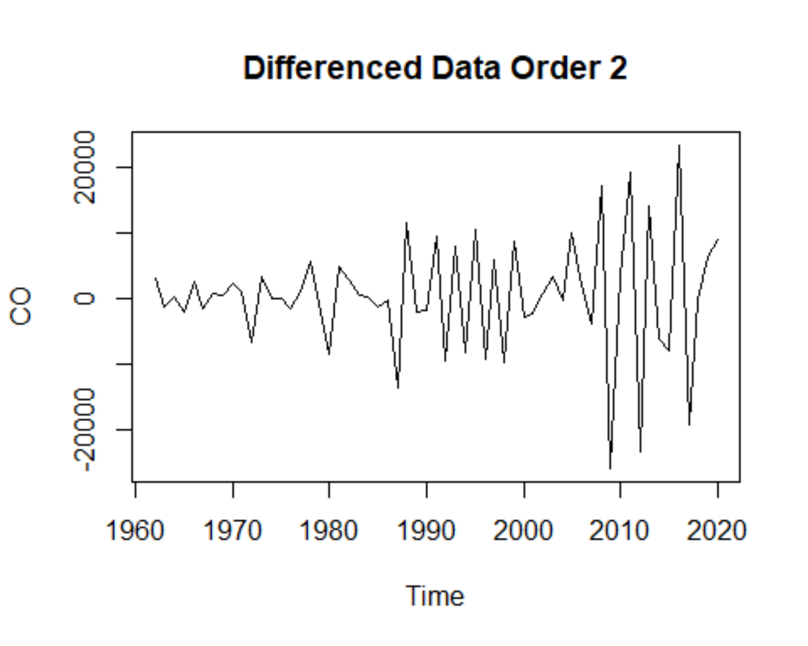
Renewable Energy Analysis

Slide 12
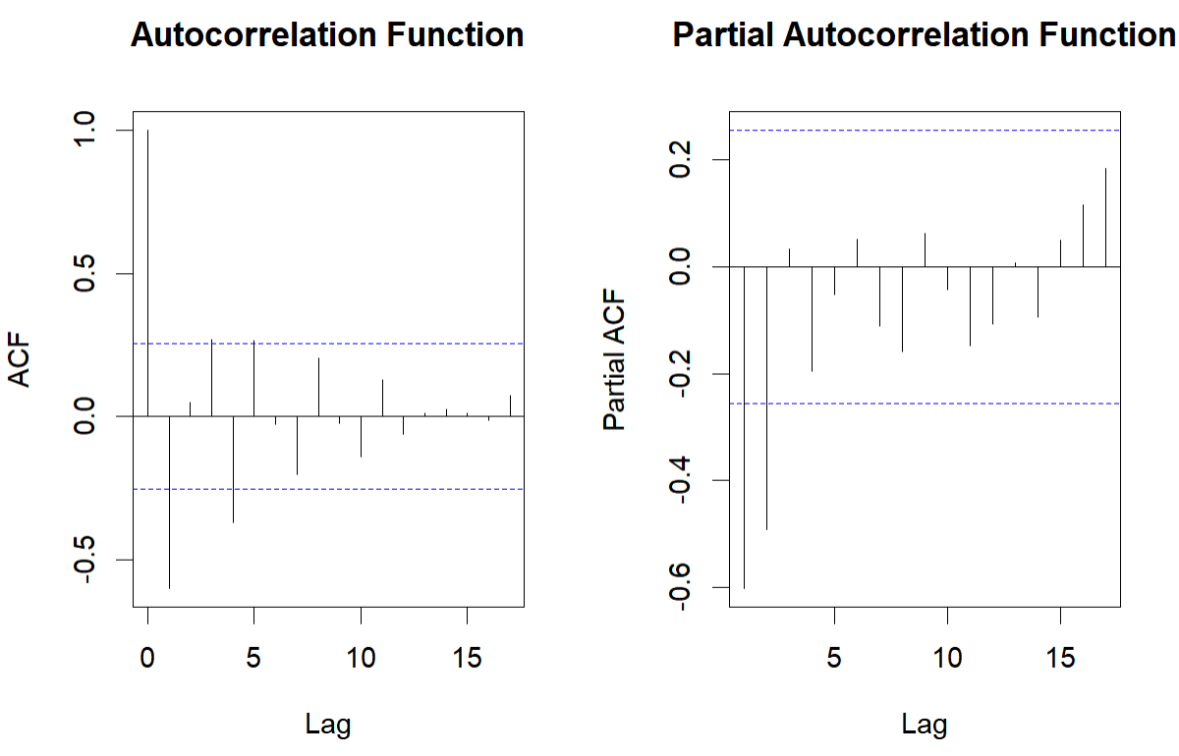
Renewable Energy Analysis
Apply ARIMA model to forecast the future renewable energy production.
From the ACF and PACF plots, we can see that PACF cuts off after lag 2 and then decayed to zero, while ACF exponential decaying to zero.
So for the initial model, I choose ARIMA(2,2,0).

Slide 13
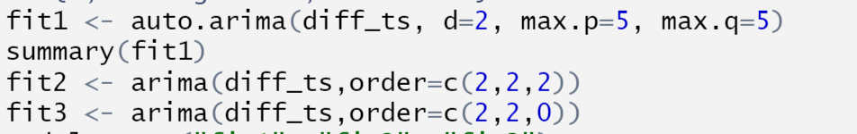
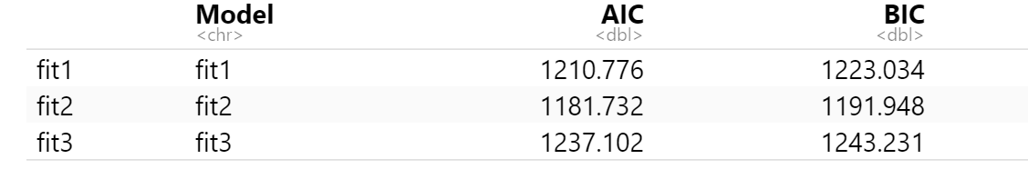
Renewable Energy Analysis
Apply auto.arima() function as a reference
The second model has the smallest AIC and BIC values, so choose ARIMA(2,2,2) as my final model to do the following forecasts.

Slide 14
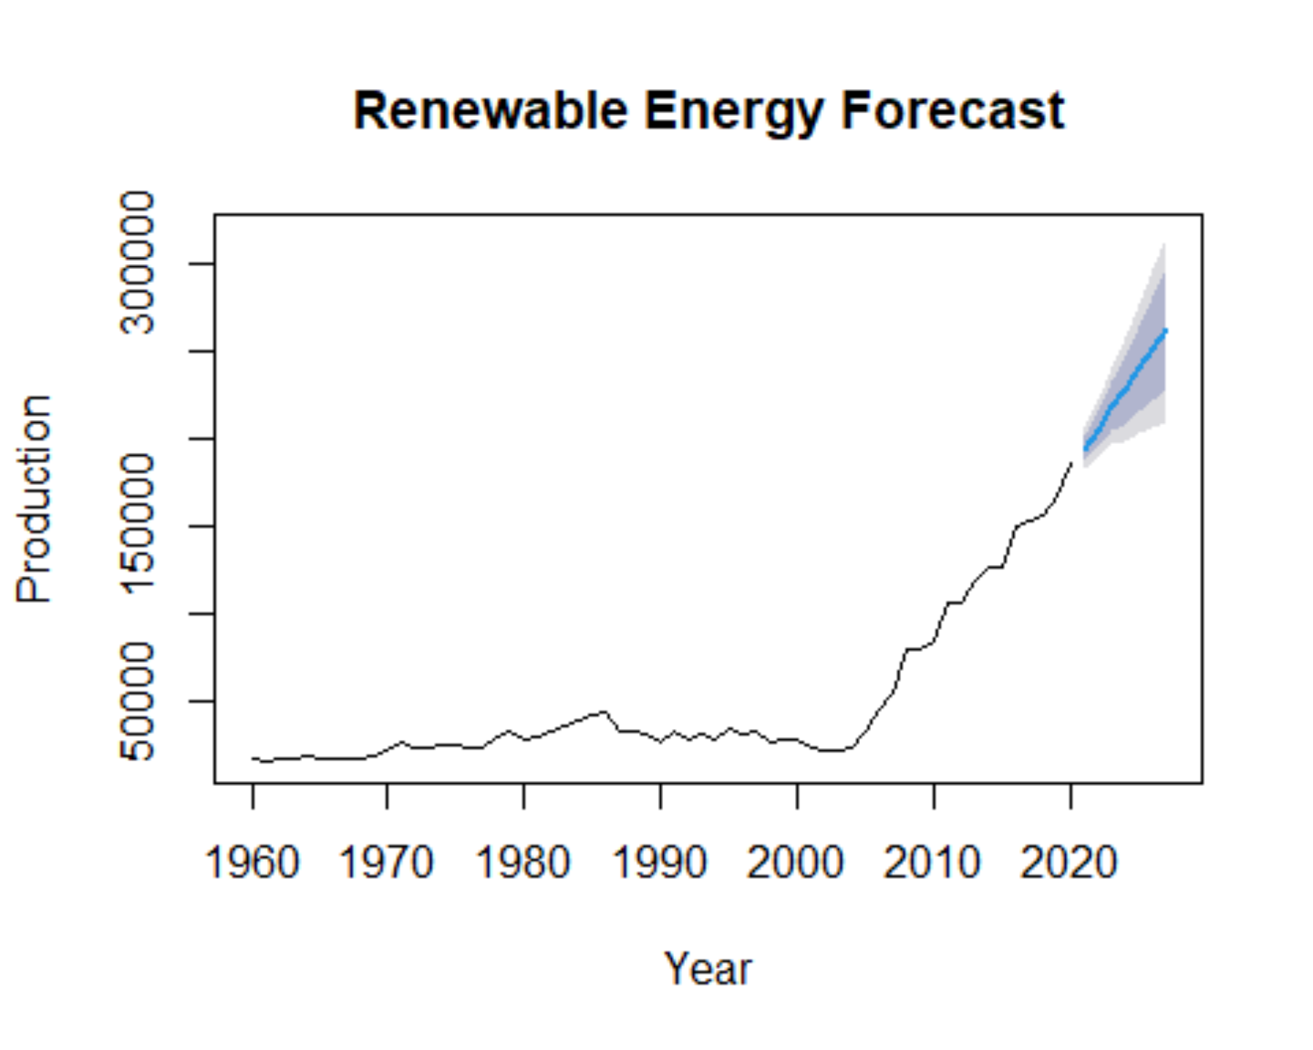
Renewable Energy Analysis
Through the picture we can see that the future energy production are in a clear upward trend in the following seven years.

Slide 15
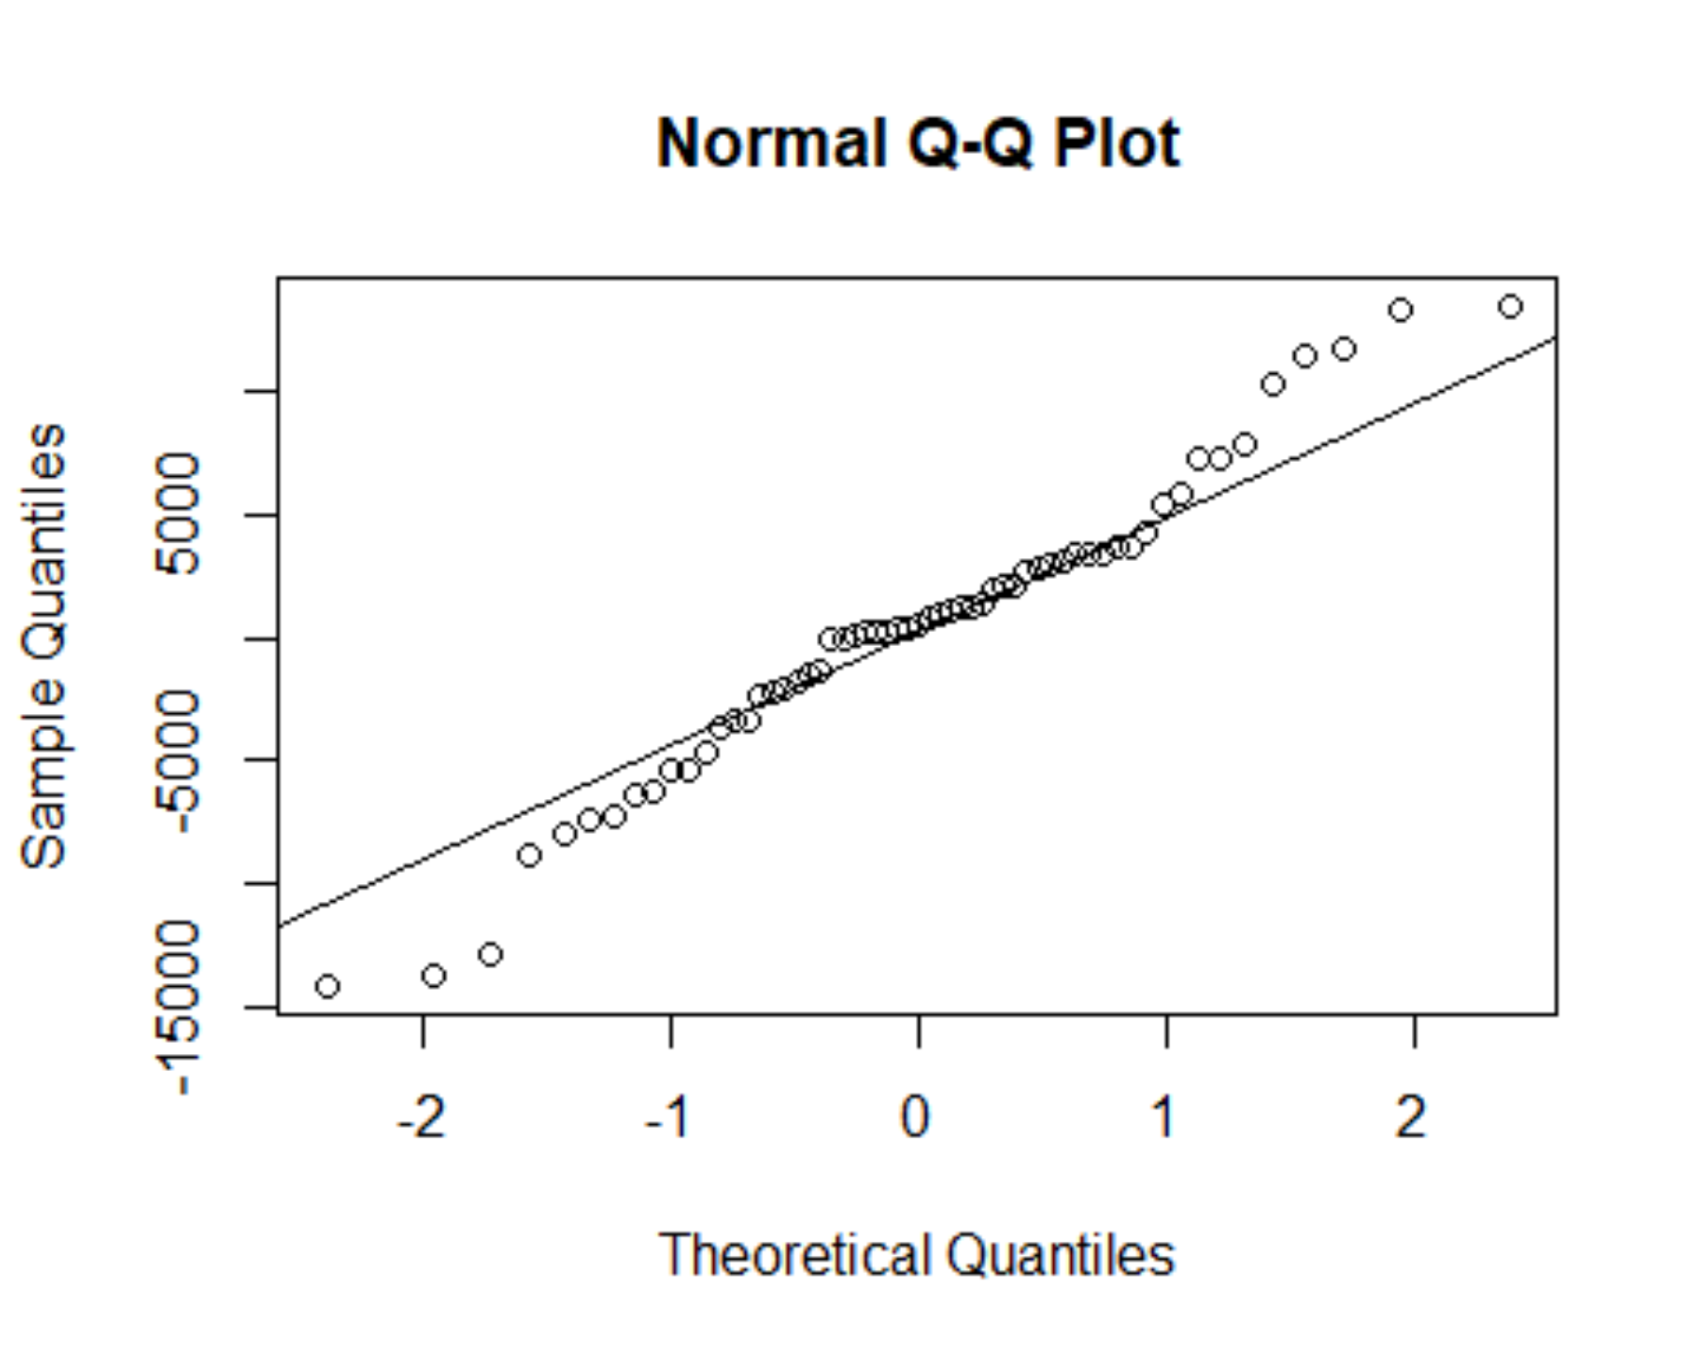
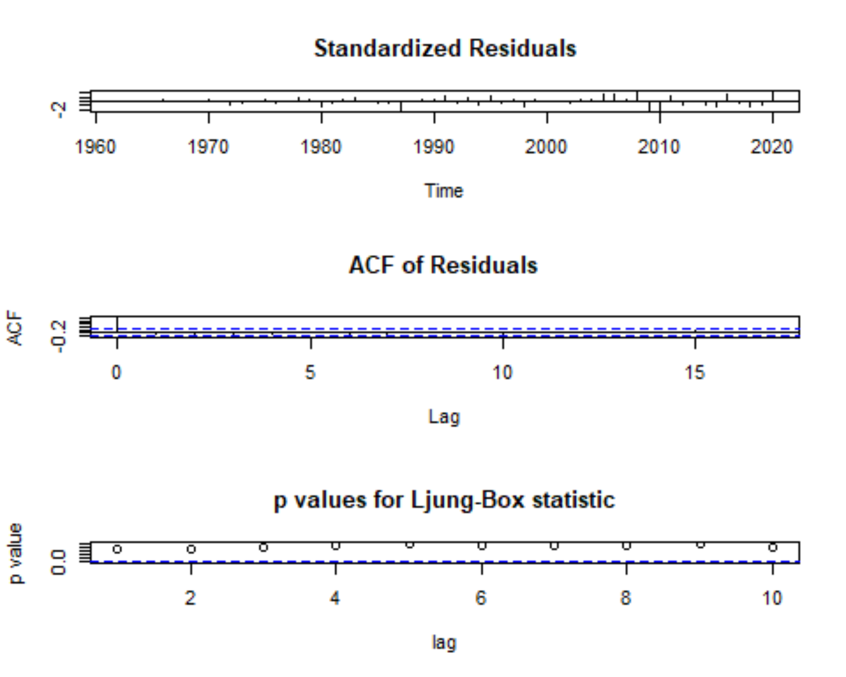
Model Evaluation

Slide 16
Model Evaluation
The QQ residual plot shows that the residuals are almost normally distributed.
The Standardized Residuals plot shows there is no clear trend or seasonality,
The ACF plot is used to check for autocorrelation in residuals, and significant spikes at lag 1 may indicate the presence of correlation between residuals and lagged values, necessitating additional model terms.
The p-values for the Ljung-Box statistic are all greater than the significance level(0.05), so the residuals are likely uncorrelated.
→ARIMA(2,2,2) is a good fit for the data.

Slide 17
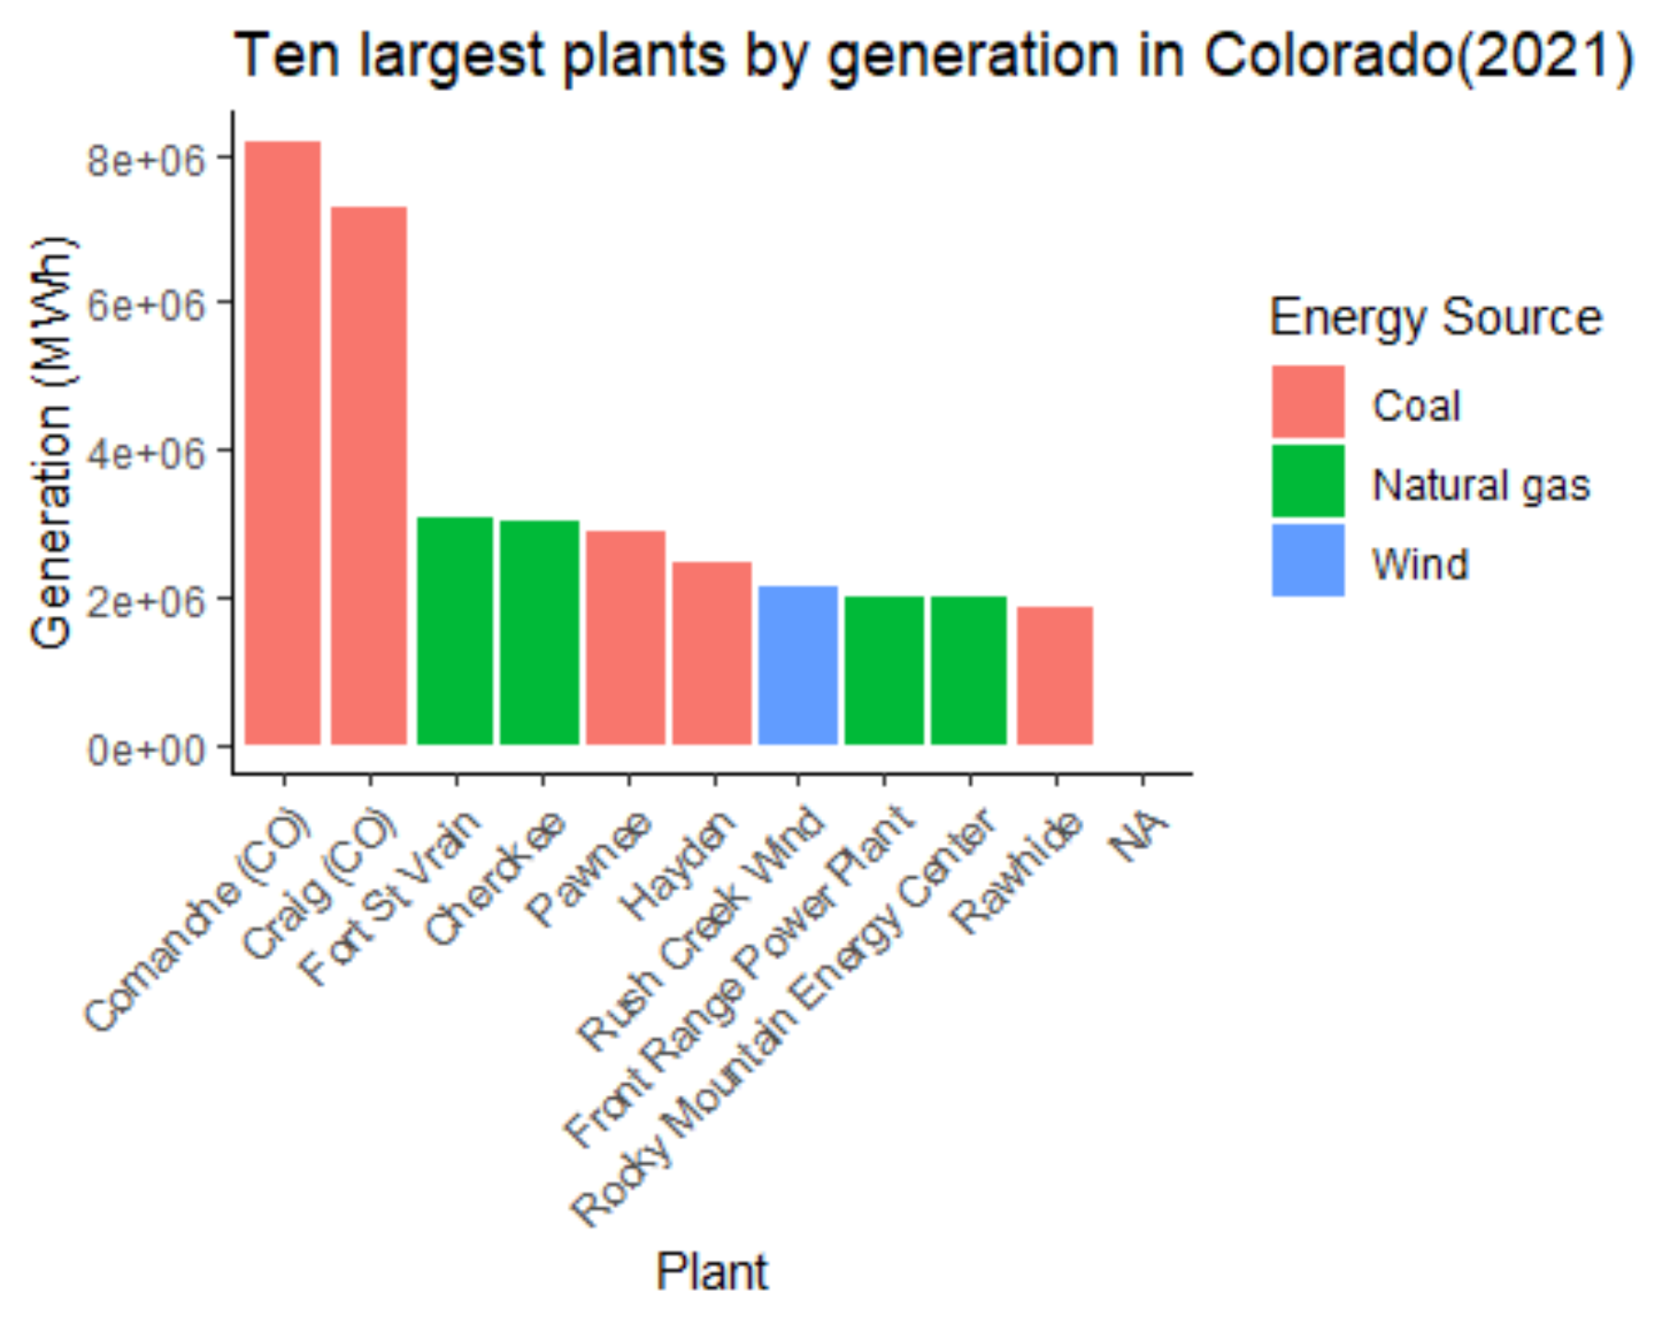
We found that wind power is starting to become important in Colorado.
Nevertheless, coal is still the main source of energy for power generation, so we focus our analysis below on wind and coal consumption.

Slide 18
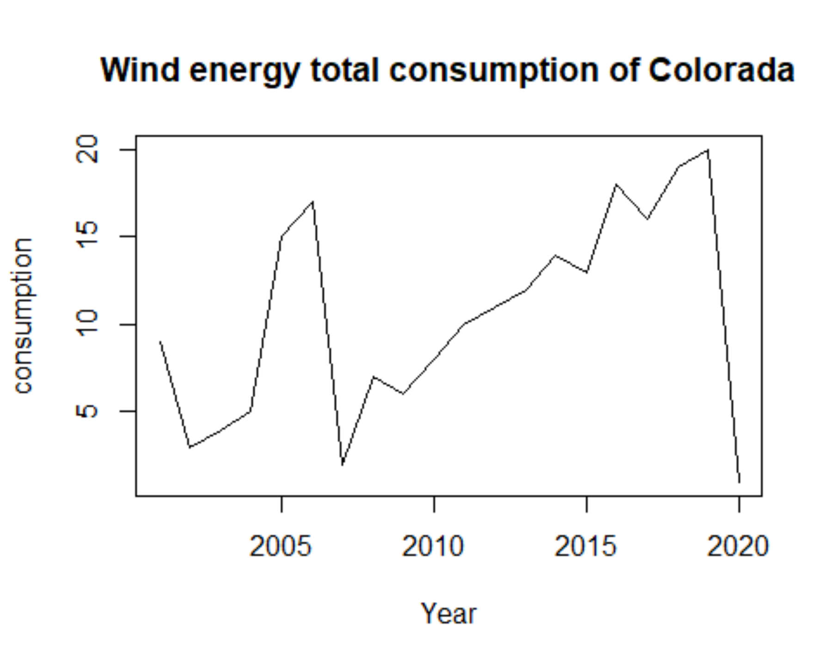
Wind consumption
We also make forecasts of wind energy total consumption. The units are billion Bu. This is the time series model of wind energy total consumption for the available years.

Slide 19
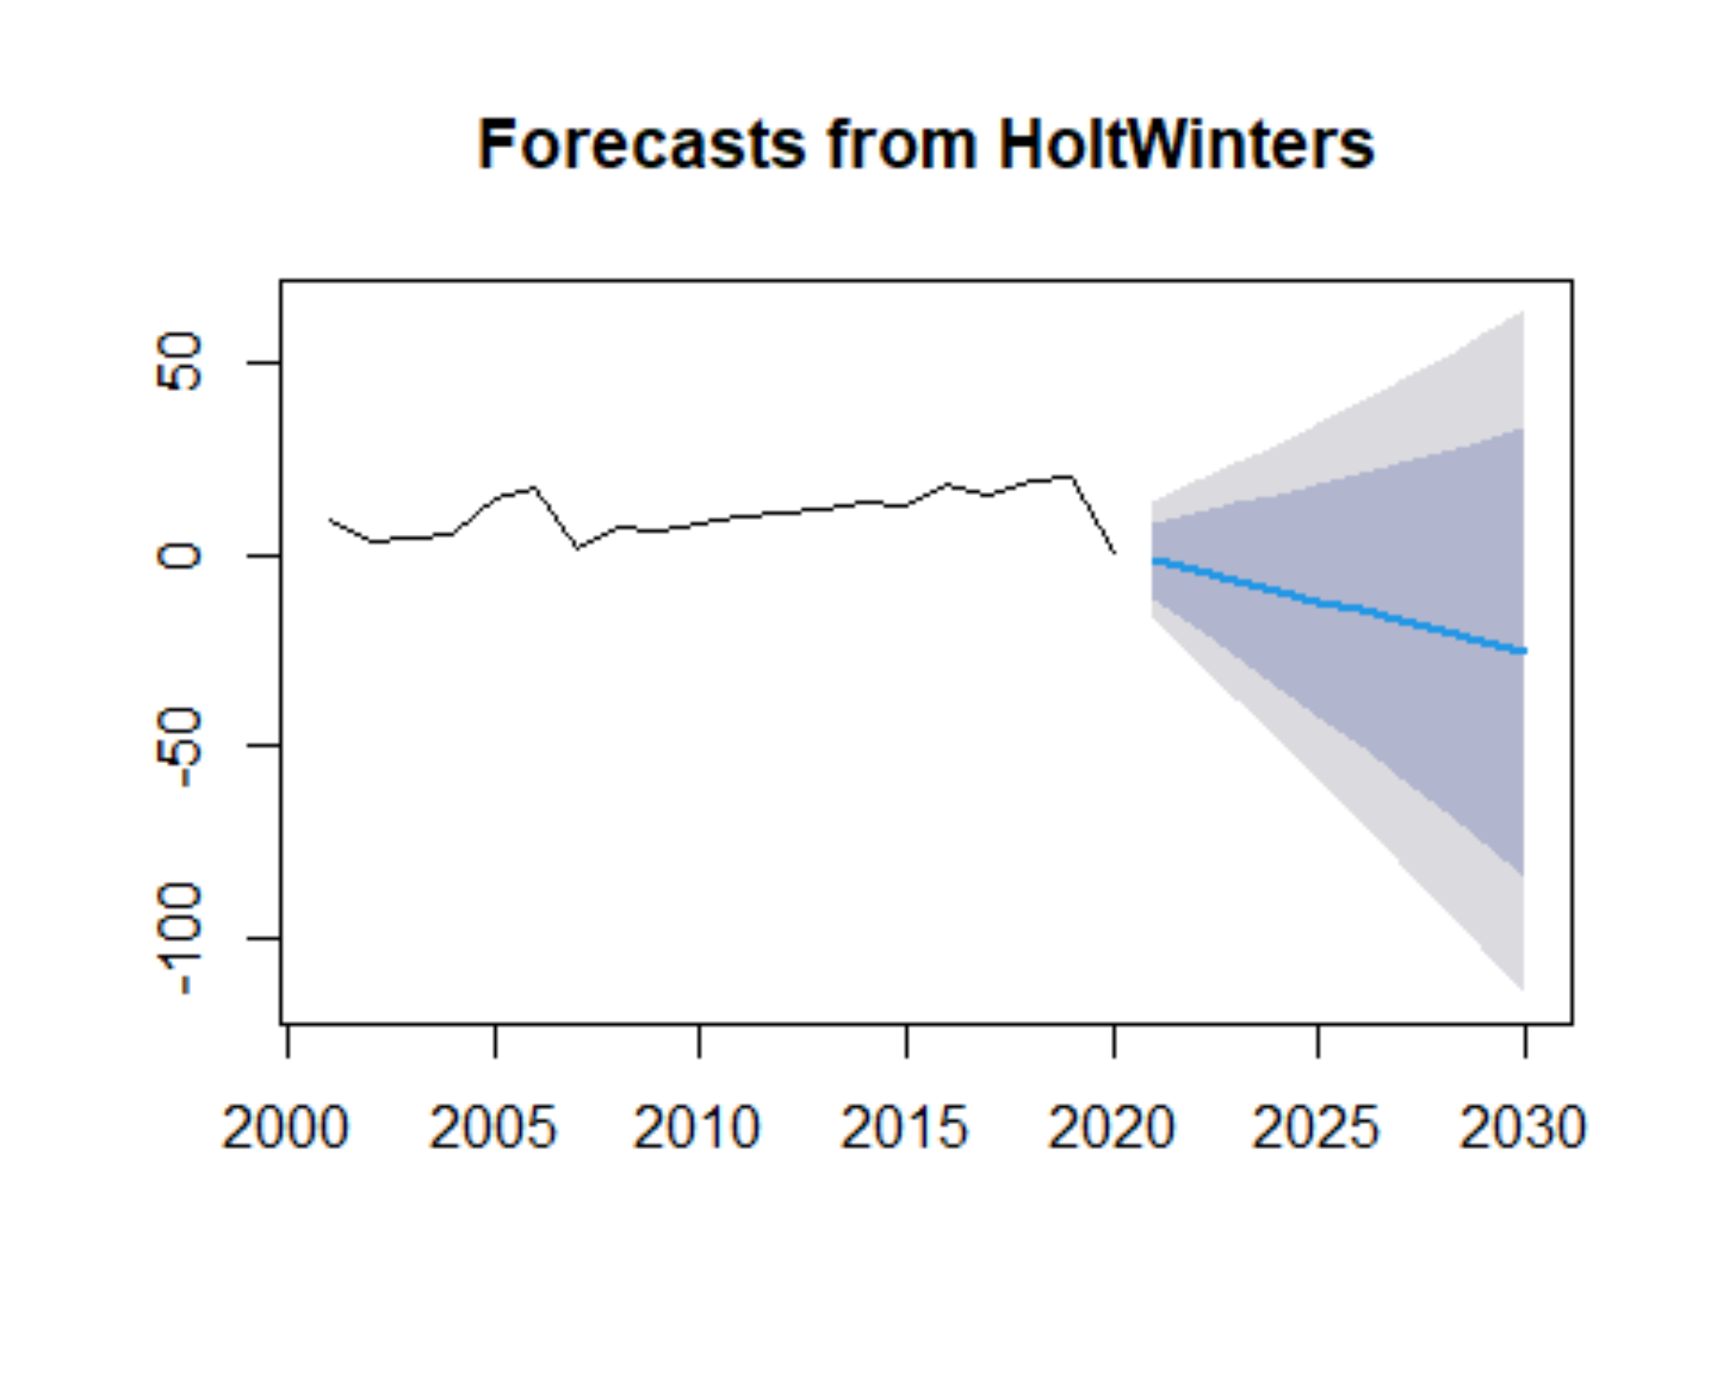
Holt-Winters Forecast
Another widely used forecast method is Holt-Winters Forecast. It utilizes a form of double exponential smoother to compute the forecast.
The future consumption of wind energy is almost flat with a slight downward trend.

Slide 20
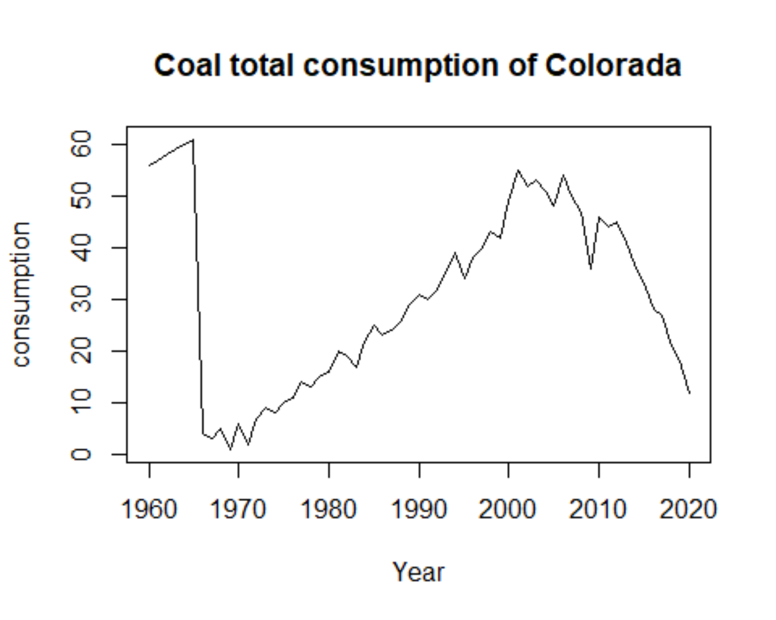
Coal(Non-renewable energy) consumption
We have also forecast future non-renewable energy consumption for comparison, using coal as an example.
After a significant increase in coal consumption from 1980 to 2020, coal consumption starts to decline from 2020.

Slide 21
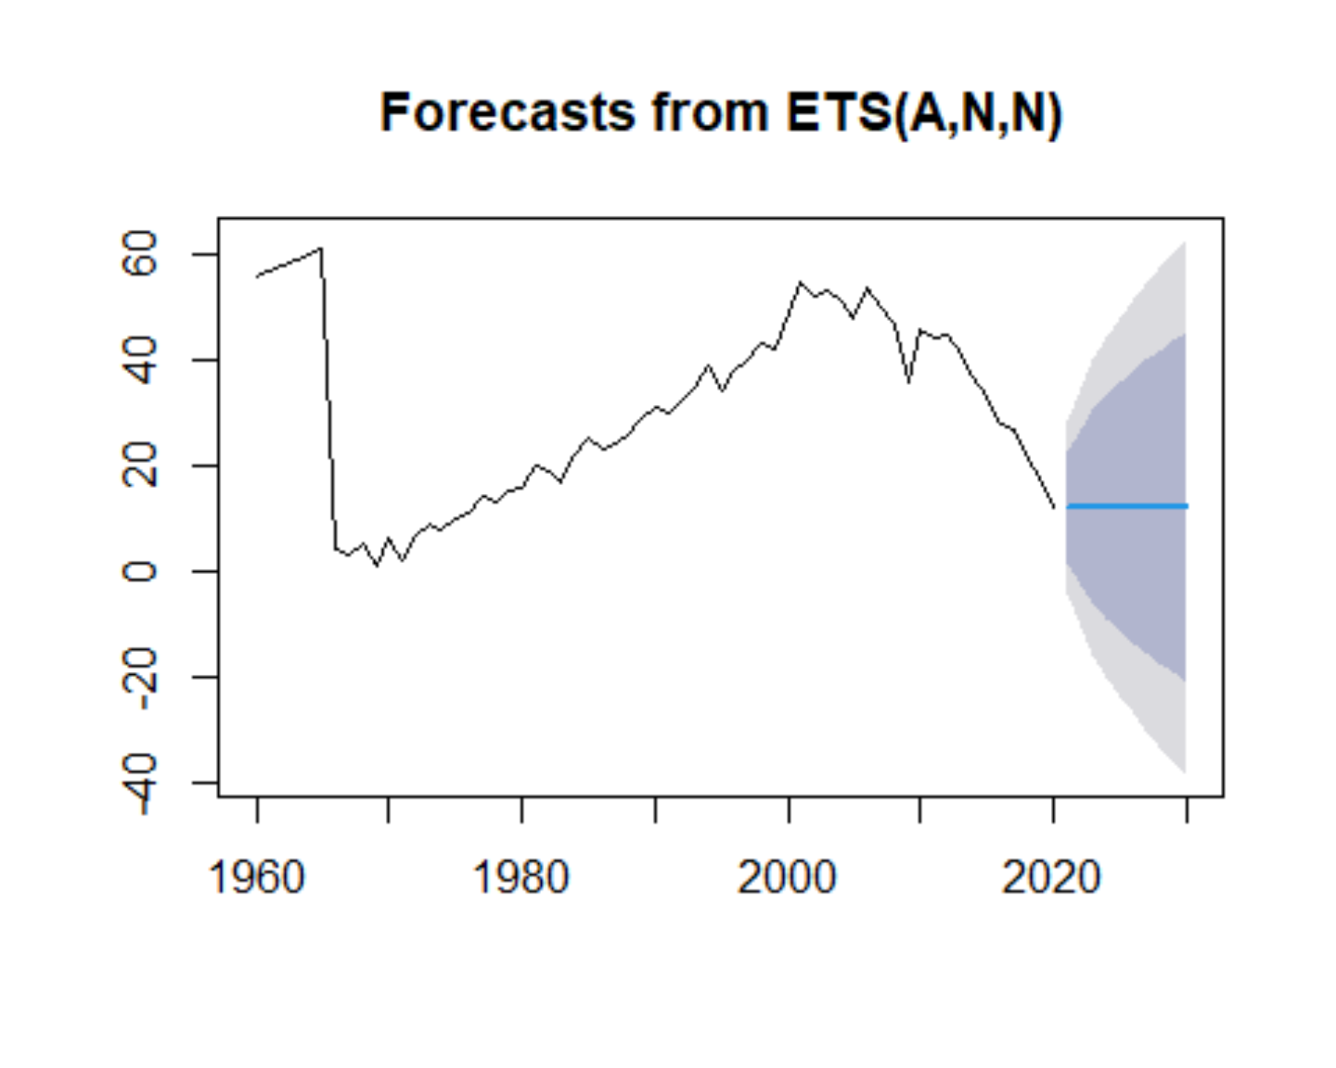
Holt-Winters Forecast
Coal consumption is basically flat, with no upward trend in the future

Slide 22
Conclusion
Colorado's electricity market is transitioning from traditional to renewable energy sources as the use of renewable energy increases.
The development of renewable energy sources has positive impacts on the environment, climate change, and provides opportunities for economic and employment development in the state.
By analyzing the revenue and pricing of monthly electricity consumption in Colorado since 1990 versus annual renewable energy consumption since 1960, we can better understand the development and future trends of the electricity market.
This analysis can provide data to support better electricity planning and decision making by government and energy companies.

